Slide 1

AI Powered E-Learning
By XXX

Slide 2
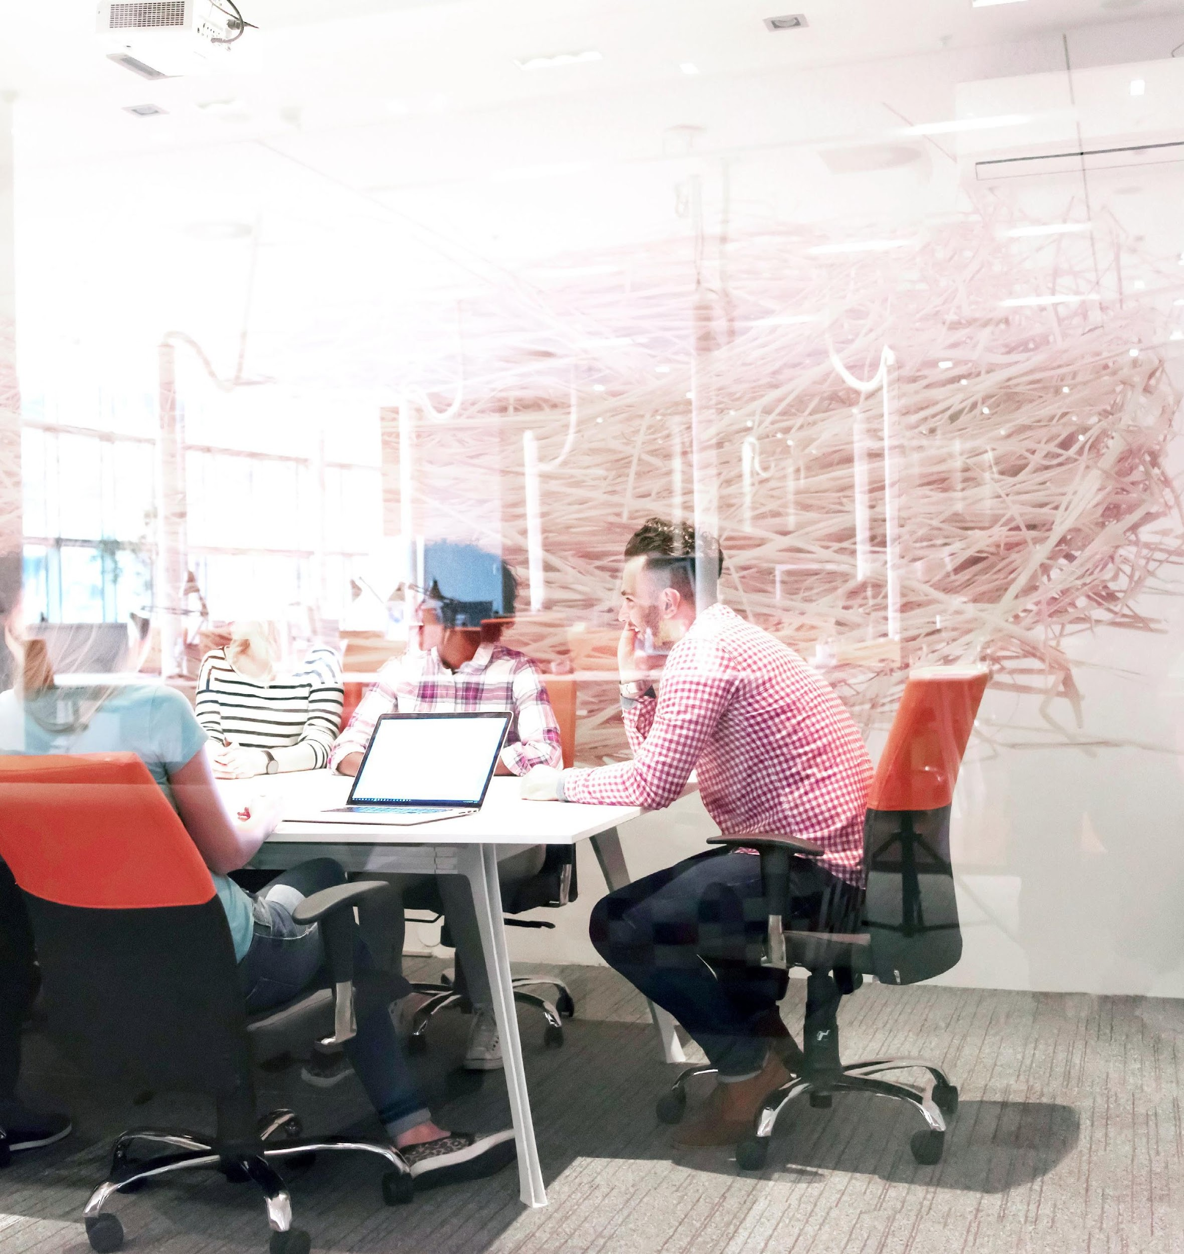

Agenda
Problem Solved
Solution
Technical Details
Weekends Progress
Impact
Requirements
Post crisis Value
Protoype and Video

Slide 3


The Concept

Slide 4

The Concept
Facilitate lifelong learning for career professionals seeking to advance their careers
Provide remote learning that is customized, adaptive and easy to consume
This is especially relevant in what has come to be a very challenging time because of COVID-19.

Slide 5




Slide 6
Key
Features

Slide 7
Key Features
An AI powered E-learning platform that provides high quality course material to enable skill development
A P2P learning community of engaged learners
Gamification of the platform to foster learning and growth in the form of fun challenges
A centralized dashboard to access your study material and track your progress

Slide 8
Technical Details

Slide 9
Technical Details
Centralized dashboard of all your courses
API based connectivity to all popular course providers
ML based interactive dashboard to curate and suggest new courses.

Slide 10
Weekend’s Progress

Slide 11
Weekend’s Progress
Mobile friend E-learning portal
Intuitive UI

Slide 12
Impact

Slide 13
Impact
Enable high quality learning for self -learners to advance their careers.
Make high quality learning material accessible for all across socio-economic backgrounds across the world.
Foster a community of learners and enable peer 2 peer learning powered by technology

Slide 14
Requirements

Slide 15
Requirements
I
Technology requirements

Slide 16
Post Crisis
Value

Slide 17
Post Value Crisis
Covid is expected to cause almost 195 million in lost jobs across the world
(UN, 2020)
People will want to distinguish themselves through skill enhancement to make themselves an asset to organizations

Slide 18
For adults who want to learn new skills to advance their careers
URL for Prototype
URL for Video
Visit bit.ly/2zfjZD4 for
a free demo
Visit bit.ly/2zfjZD4 for
a free demo

Slide 19
Thank You!

Slide 20
PLEASE IGNORE ALL THE SLIDES AFTER THIS POINT

Slide 21
Project Scope

Slide 22
Target Audience
Adults who want to learn new skills to advance their careers.

Slide 23
User Goals
Personalization – Track learning progress.
Gamification – Keep yourself motivated by engaging in fun challenges
Community – Be part of a larger learning community as you share your learnings with friends and others.

Slide 24
Design Questions
As the world is fighting against the COVID-19 outbreak, more than 130 countries have now closed schools nationwide, impacting nearly 80% of students globally.
How can we build an MVP to help these students to stay motivated through engaging and effective learning experience?

Slide 25
Design Questions
What are the triggers to help them to stay motivated?
Almost all Educational Institutions in Europe as been temporarily closed. How can learning continue?

Slide 26
Metrics
Effectiveness
Efficiency
Engagement
Creativity
Simple and practical

Slide 27
Challenges
Some school students might be already using internal tool built in school system.
Blackboards, Canvas etc.,
There is lack of engagement among students and this can affect their mental health.

Slide 28
User Goals
User wants to stay motivated
User wants to build self-study habits
User needs someone (ex: teacher) to guide and motivate themselves
User needs resources to complete the learning tasks
User needs help from the lockdown to boost mental health

Slide 29
For adults who want to learn new skills to advance their careers
Visit bit.ly/2zfjZD4 for
a free demo

